Slide 1
INSIDE OUT
2024 Quarter 3 Lesson 06
Mark 7, 8

Slide 2
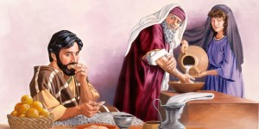
Pharisaical Handwashing
Mark 7:1-5
1 Then came together unto him the Pharisees, and certain of the scribes, which came from Jerusalem.
2 And when they saw some of his disciples eat bread with defiled, that is to say, with unwashen, hands, they found fault.

Slide 3
Pharisaical Handwashing
Mark 7:3-5
3 For the Pharisees, and all the Jews, except they wash their hands oft, eat not, holding the tradition of the elders.

Slide 4
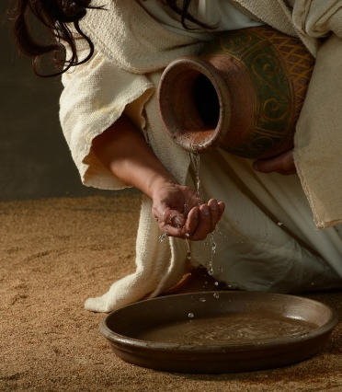
Pharisaical Handwashing
Mark 7:4-5
4 And when they come from the market, except they wash, they eat not. And many other things there be, which they have received to hold, as the washing of cups, and pots, brasen vessels, and of tables.

Slide 5
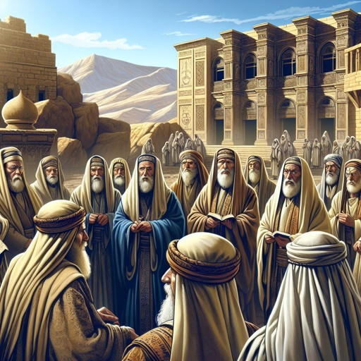
Pharisaical Handwashing
Mark 7:5
5 Then the Pharisees and scribes asked him, Why walk not thy disciples according to the tradition of the elders, but eat bread with unwashen hands?

Slide 6
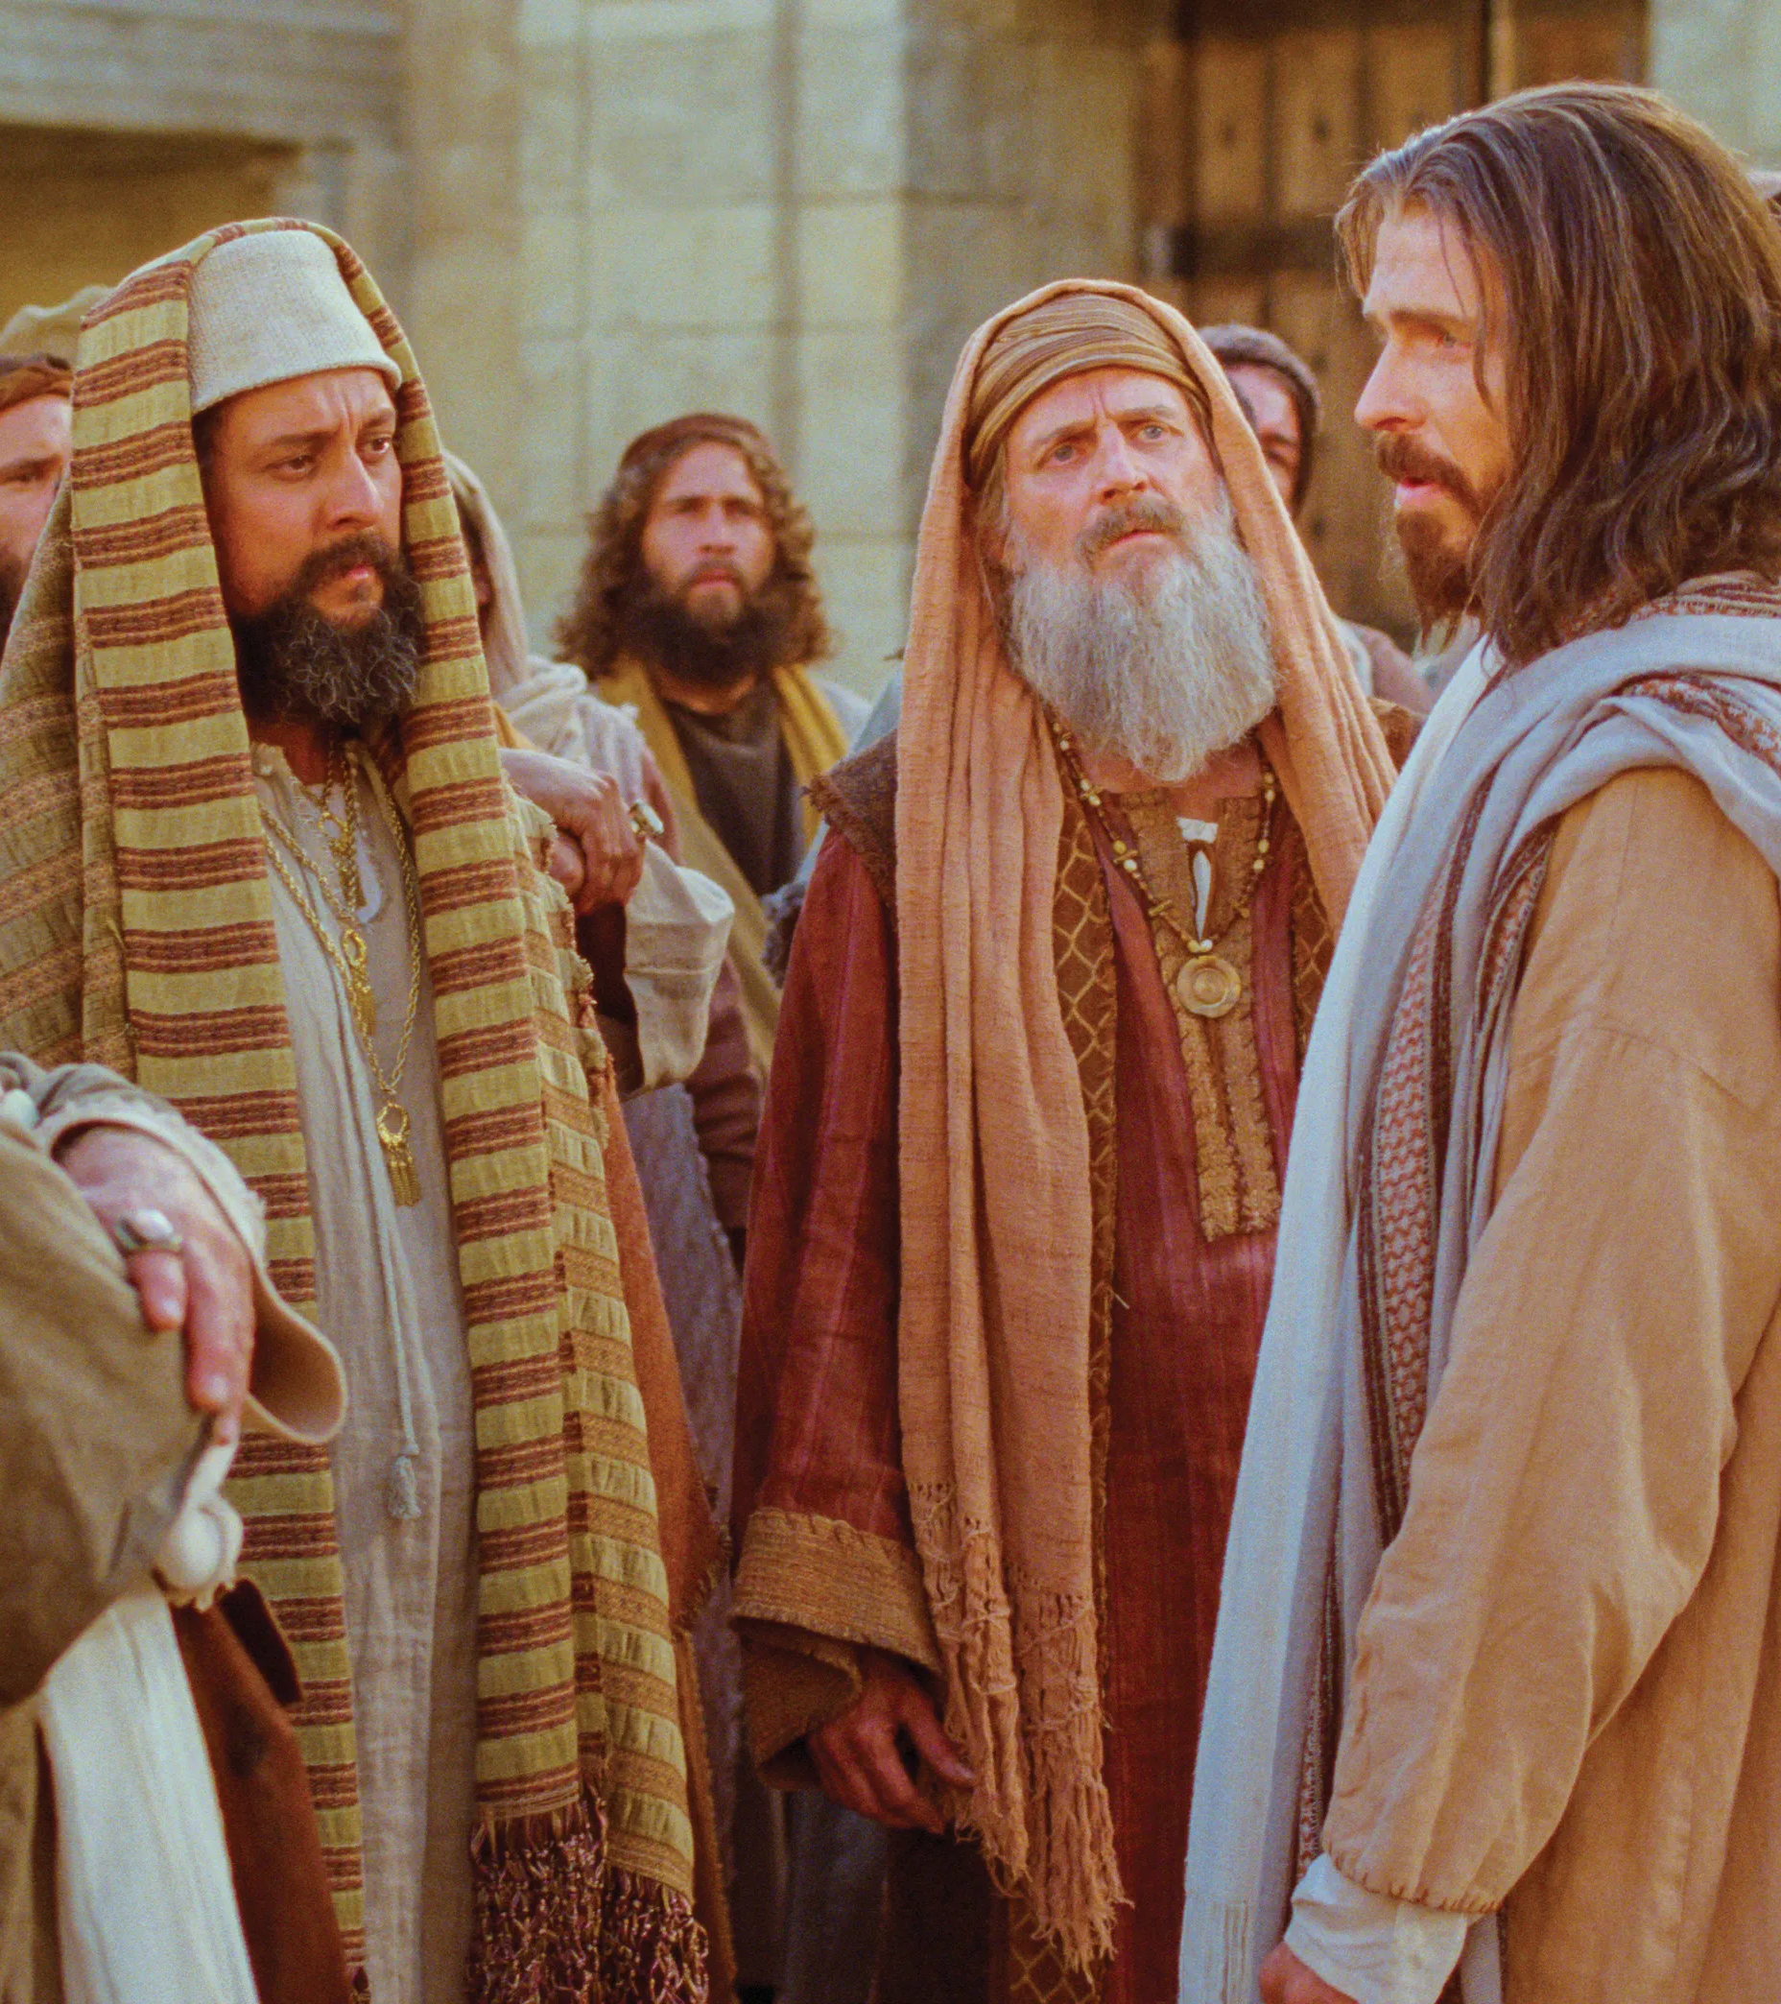
Tradition or Cleanliness?
Matthew 15:1-3
15 Then came to Jesus scribes and Pharisees, which were of Jerusalem, saying,
2 Why do thy disciples transgress the tradition of the elders? for they wash not their hands when they eat bread.

Slide 7
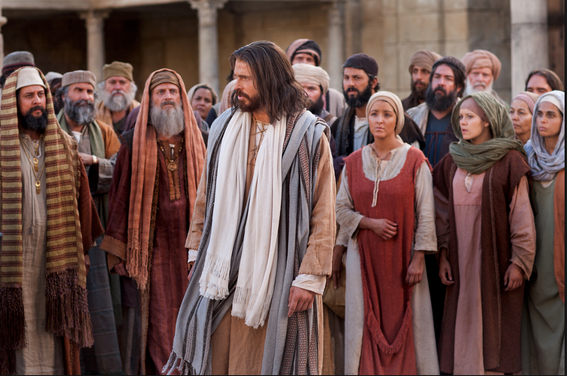
Tradition or Cleanliness?
Matthew 15:1-3
3 But he answered and said unto them, Why do ye also transgress the commandment of God by your tradition?

Slide 8
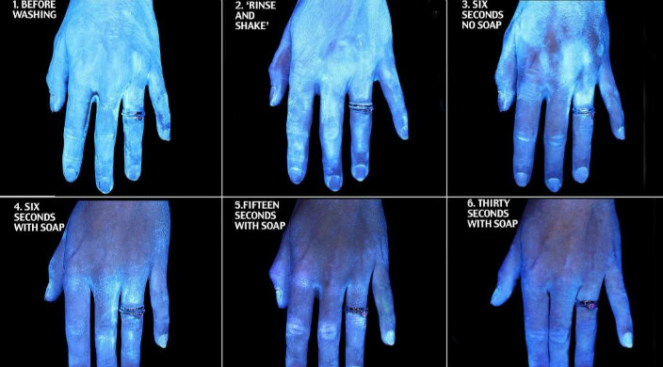

Slide 9
Normal human skin is colonized by bacteria, with total aerobic bacterial counts ranging from more than 1,000,000 colony forming units (CFU)/cm² on the scalp, 500,000 CFUs/cm² in the axilla, and 40,000 CFU/cm² on the abdomen to 10,000 CFU/cm² on the forearm.
World Health Organization, 2009

Slide 10
Total bacterial counts on the hands of healthcare workers have ranged from 39,000 to 4,600,000 CFU/cm². Fingertip contamination ranged from 0 to 300 CFU when sampled by agar contact methods.
World Health Organization, 2009

Slide 11
In 1938, Price established that bacteria recovered from the hands could be divided into two categories, namely resident or transient. Resident flora has two main protective functions: microbial antagonism and the competition for nutrients in the ecosystem.
World Health Organization, 2009

Slide 12
Transient flora (transient microbiota), which colonizes the superficial layers of the skin, is more amenable to removal by routine hand hygiene. Transient microorganisms do not usually multiply on the skin, but they survive and sporadically multiply on skin surface.
World Health Organization, 2009

Slide 13
Subsequent investigators documented that although the count of transient and resident flora varies considerably among individuals, it is often relatively constant for any given individual.
World Health Organization, 2009

Slide 14
“I am made all things to all men, that I might by all means save some.” 1 Cor. 9:22
There’s nothing contrary to God’s Law about washing your hands—even doing it in such a way as the Pharisees prescribed.
Why didn’t Jesus just go along with the Pharisee’s little ritual? A bit of water never did anyone any harm.

Slide 15
“I am made all things to all men, that I might by all means save some.” 1 Cor. 9:22
More than that, modern scientific knowledge certainly supports the idea that frequent handwashing saves lives. Why didn’t Jesus go along with it just so that He’d be, as one commentator put it, “on the right side of history”?
Let’s take a closer look at exactly what He was dealing with…

Slide 16
The Talmud used the requirement of handwashing in Leviticus 15:11 as support for a general handwashing law.
In Talmudic hermeneutics, it’s possible to use a Bible verse as a “hint” (called asmachta) to support rabbinical requirements even if that verse doesn’t directly address the rule under examination.
11 And whomsoever he toucheth that hath the issue, and hath not rinsed his hands in water, he shall wash his clothes, and bathe himself in water, and be unclean until the even.

Slide 17
Halakha requires the hands to be washed before eating a meal containing bread.
The Halakha is the collective body of Jewish religious laws that are derived from the Written and Oral Torah.
“Handwashing” as defined by the religious tradition is an act that involves pouring water over both hands up to the wrists. In some places, this act is repeated twice.

Slide 18
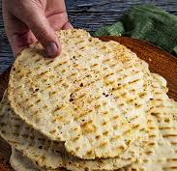
This only applies to bread made from one of the five chief grains (wheat, cultivated barley, spelt, wild barley, and oats).
Bread made with millet, teff, couscous, amaranth, farro, freekeh or quinoa doesn’t count. Cornbread is okay too. So much for “ancient grains!” But don’t think the detailed rules stop here…

Slide 19
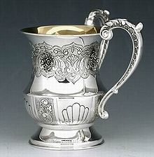
The washing is performed by pouring water from a cup over each hand.
This involved pouring a small quantity of water upon the fingers and palm of first one hand and then the other with the hand titled so that the water ran from the palm to the wrist, but no farther (all the time care being taken lest the water run back into the palm).

Slide 20
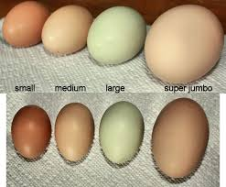
The minimum amount of water prescribed was that which could be contained in one and a half egg shells.
I can personally vouch for the fact that eggs come in a range of different sizes. Even assuming that these are chicken eggs!

Slide 21
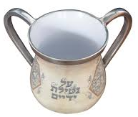
After the first hand is washed, it is pure. The unwashed hand is not. If the two hands touch after the first hand was washed, it is necessary to rewash the first one.
Later guidelines mandated the use of a two-handled cup to make the process simpler, as the hands had to avoid touching each other.

Slide 22
Rabbinic law requires that travelers go as far as four Biblical miles to obtain water for washing prior to eating bread.
The length of a Biblical mile in today’s measure is not entirely clear. (It depends on the length one assigns a “cubit.”) But estimates involve a man walking a Biblical mile in 18-24 minutes.
If there is a known water source there.
This applies only to when the water source lies in one's direction of travel.

Slide 23
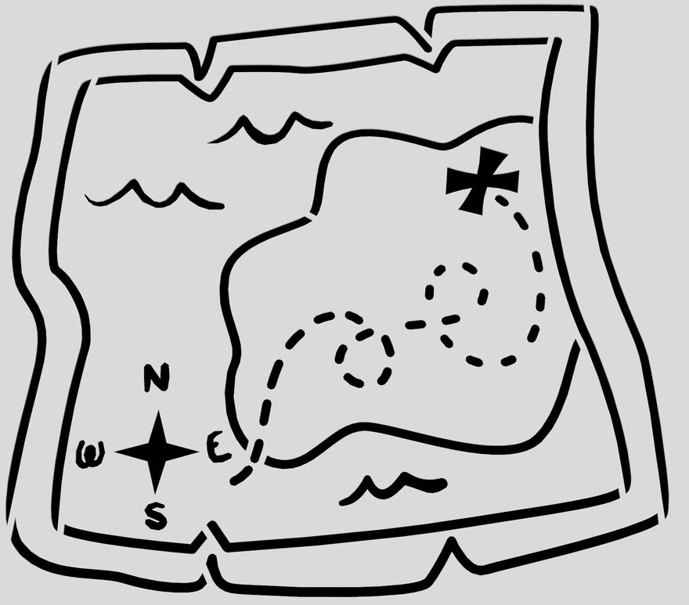
If the traveler already passed the water source, he is only obligated to backtrack to a distance of one Biblical mile.
These rules appear to require a quite extensive knowledge of local geography and a fairly precise sense of distance.

Slide 24
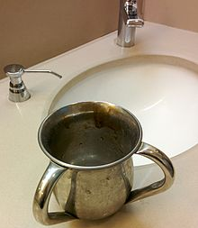
If there was no water available, a person would simply go through the motions of washing his hands as described.
I’m not sure what this is meant to achieve, but I suppose exceptions occasionally had to be made.

Slide 25
Tradition or Cleanliness?
Matthew 15:1-3
2 Why do thy disciples transgress the tradition of the elders? for they wash not their hands when they eat bread.
3 But he answered and said unto them, Why do ye also transgress the commandment of God by your tradition?

Slide 26
“I am made all things to all men, that I might by all means save some.” 1 Cor. 9:22
There’s nothing quite as dangerous as a false sense of security! The Pharisees here believe themselves to be secure in God’s favor because of their efforts to be ritually clean. Jesus isn’t objecting to handwashing. But He must object to the misleading practices that were giving these people a false sense of security.

Slide 27
The Desire of Ages pg. 396
“
“The rules in regard to purification were numberless. The period of a lifetime was scarcely sufficient for one to learn them all. The life of those who tried to observe the rabbinical requirements was one long struggle against ceremonial defilement, an endless round of washings and purifications.”
”

Slide 28
The Desire of Ages pg. 396
“
“While the people were occupied with trifling distinctions, and observances which God had not required, their attention was turned away from the great principles of His law.”
”

Slide 29
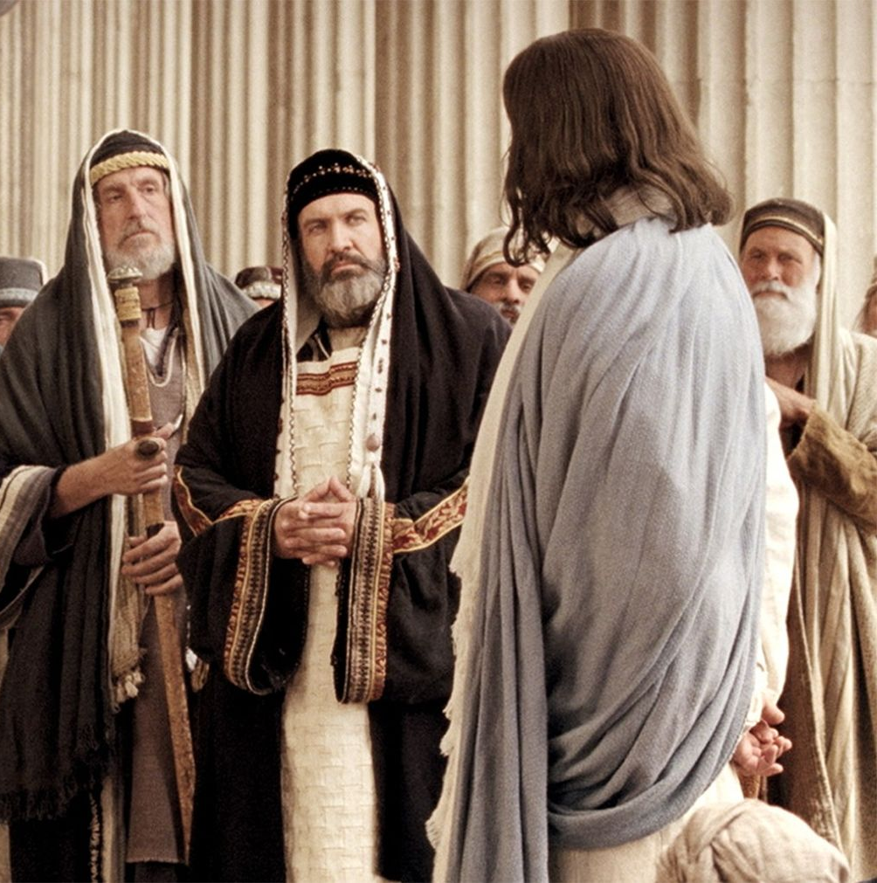
Exalting the TRUTH
Mark 7:5-24
5 Then the Pharisees and scribes asked him, Why walk not thy disciples according to the tradition of the elders, but eat bread with unwashen hands?
6 He answered and said unto them, Well hath Esaias prophesied of you hypocrites, as it is written, This people honoureth me with their lips, but their heart is far from me.

Slide 30
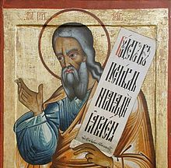
Exalting the TRUTH
Mark 7:7-24
7 Howbeit in vain do they worship me, teaching for doctrines the commandments of men.
8 For laying aside the commandment of God, ye hold the tradition of men, as the washing of pots and cups: and many other such like things ye do.

Slide 31
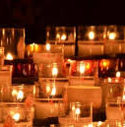
The Commandments of Men
Isaiah 29:13-16
13 Wherefore the Lord said, Forasmuch as this people draw near me with their mouth, and with their lips do honour me, but have removed their heart far from me, and their fear toward me is taught by the precept of men:

Slide 32

The Commandments of Men
Isaiah 29:14-16
14 Therefore, behold, I will proceed to do a marvellous work among this people, even a marvellous work and a wonder: for the wisdom of their wise men shall perish, and the understanding of their prudent men shall be hid.

Slide 33

The Commandments of Men
Isaiah 29:15-16
15 Woe unto them that seek deep to hide their counsel from the Lord, and their works are in the dark, and they say, Who seeth us? and who knoweth us?

Slide 34
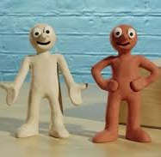
The Commandments of Men
Isaiah 29:16
16 Surely your turning of things upside down shall be esteemed as the potter's clay: for shall the work say of him that made it, He made me not? or shall the thing framed say of him that framed it, He had no understanding?

Slide 35

Exalting the TRUTH
Mark 7:9-24
9 And he said unto them, Full well ye reject the commandment of God, that ye may keep your own tradition.
10 For Moses said, Honour thy father and thy mother; and, Whoso curseth father or mother, let him die the death:

Slide 36
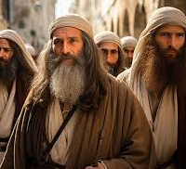
Exalting the TRUTH
Mark 7:11-24
11 But ye say, If a man shall say to his father or mother, It is Corban, that is to say, a gift, by whatsoever thou mightest be profited by me; he shall be free.
12 And ye suffer him no more to do ought for his father or his mother;

Slide 37
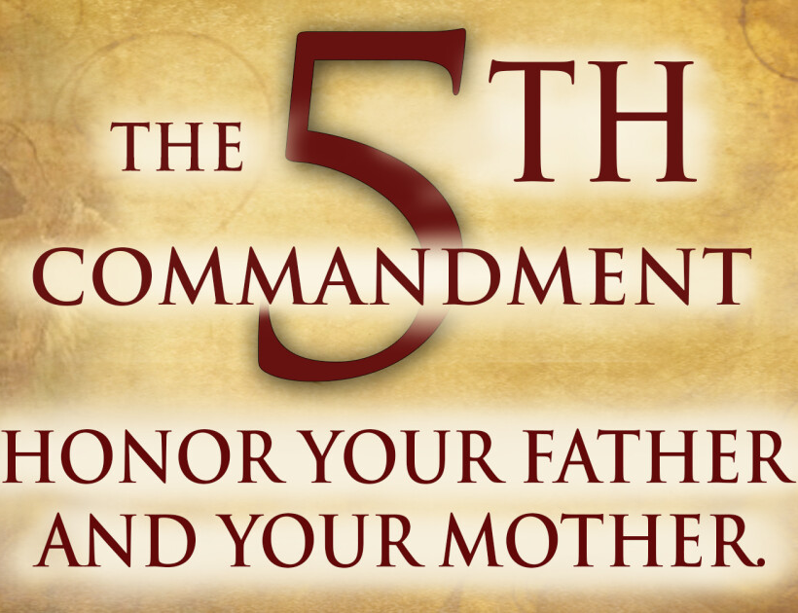
Exalting the TRUTH
Mark 7:13-24
13 Making the word of God of none effect through your tradition, which ye have delivered: and many such like things do ye.

Slide 38
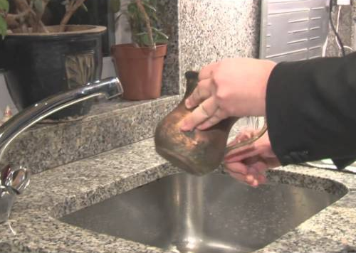
What’s most IMPORTANT?
The Gemarah of the Babylonian Talmud includes an argument that washing before meals is so important that neglecting it is tantamount to unchastity, and risks divine punishment in the form of sudden destruction or poverty.

Slide 39
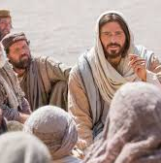
Exalting the TRUTH
Mark 7:13-24
14 And when he had called all the people unto him, he said unto them, Hearken unto me every one of you, and understand:

Slide 40

Exalting the TRUTH
Mark 7:15-24
15 There is nothing from without a man, that entering into him can defile him: but the things which come out of him, those are they that defile the man.
16 If any man have ears to hear, let him hear.

Slide 41
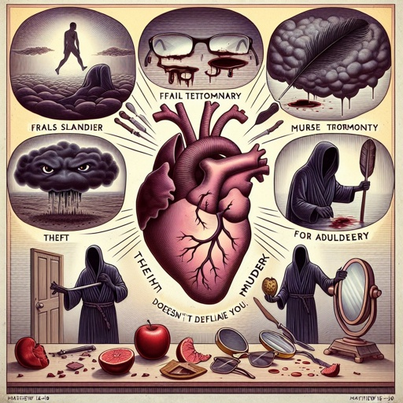
Exalting the TRUTH
Mark 7:15-24
17 And when he was entered into the house from the people, his disciples asked him concerning the parable.
18 And he saith unto them, Are ye so without understanding also? Do ye not perceive, that whatsoever thing from without entereth into the man, it cannot defile him;

Slide 42
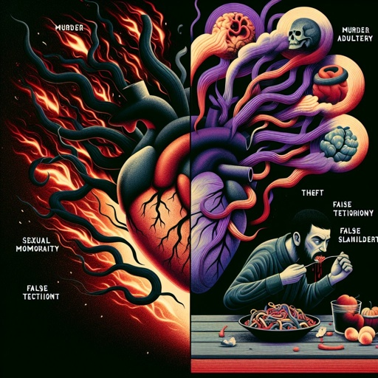
Exalting the TRUTH
Mark 7:19-24
19 Because it entereth not into his heart, but into the belly, and goeth out into the draught, purging all meats?
20 And he said, That which cometh out of the man, that defileth the man.
21 For from within, out of the heart of men, proceed evil thoughts, adulteries, fornications, murders,

Slide 43
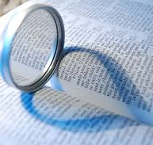
Exalting the TRUTH
Mark 7:19-24
22 Thefts, covetousness, wickedness, deceit, lasciviousness, an evil eye, blasphemy, pride, foolishness:
23 All these evil things come from within, and defile the man.
24 And from thence he arose, and went into the borders of Tyre and Sidon, and entered into an house, and would have no man know it: but he could not be hid.

Slide 44
SDABC on Mark 7:3
“
“In process of time the Rabbinical oral tradition, originally intended to protect the written law of the Old Testament, came to be considered more sacred than the law itself.”
”

Slide 45
SDABC on Mark 7:3
“
“Presumably, by a mechanical obedience to the requirements of oral tradition, a person would automatically be keeping the written law, including the Ten Commandments.”
”

Slide 46
SDABC on Mark 7:3
“
“In other words, if a person complied with the letter of the traditional interpretation of the law, he need not concern himself with the spirit of the written law.”
”

Slide 47
SDABC on Mark 7:3
“
“This legalistic system reduced religion to a matter of form and banished the spirit of true worship and obedience, without which a man serves God in vain.”
”

Slide 48
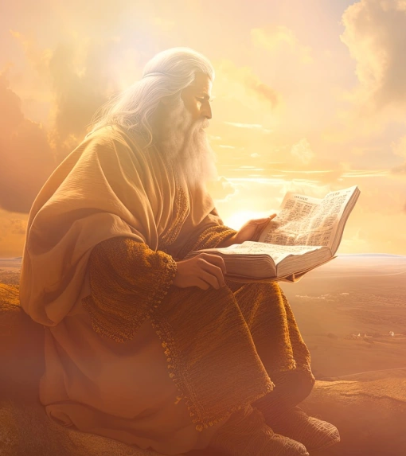
Tradition or Cleanliness?
Isaiah 1:2-4, 10-17
2 Hear, O heavens, and give ear, O earth: for the Lord hath spoken, I have nourished and brought up children, and they have rebelled against me.

Slide 49
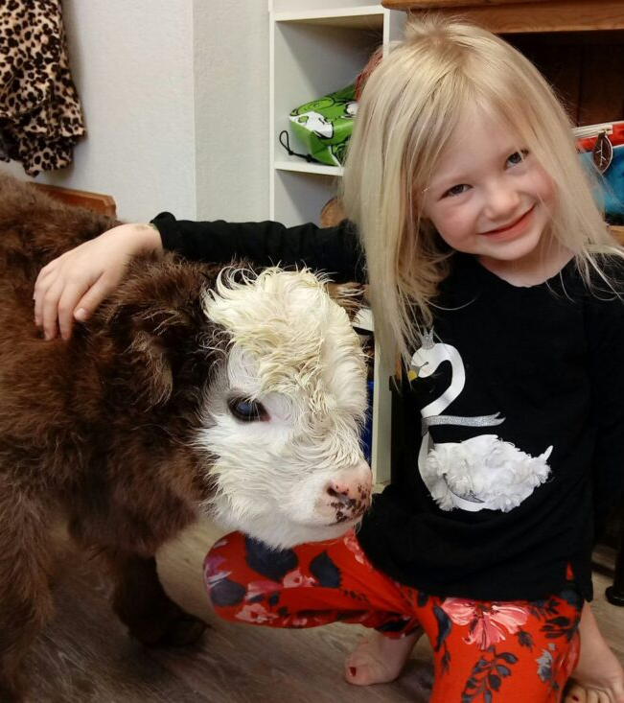
Tradition or Cleanliness?
Isaiah 1:3-4, 10-17
3 The ox knoweth his owner, and the ass his master's crib: but Israel doth not know, my people doth not consider.

Slide 50
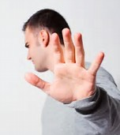
Tradition or Cleanliness?
Isaiah 1:4, 10-17
4 Ah sinful nation, a people laden with iniquity, a seed of evildoers, children that are corrupters: they have forsaken the Lord, they have provoked the Holy One of Israel unto anger, they are gone away backward.

Slide 51
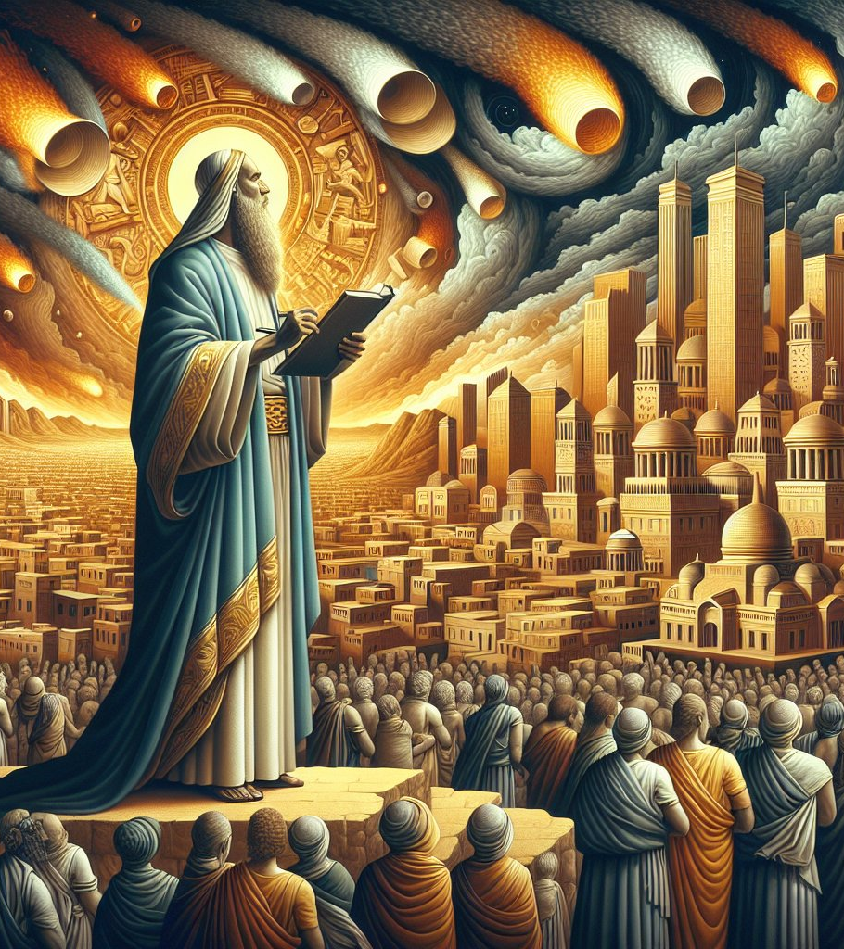
Tradition or Cleanliness?
Isaiah 1:10-17
10 Hear the word of the Lord, ye rulers of Sodom; give ear unto the law of our God, ye people of Gomorrah.

Slide 52
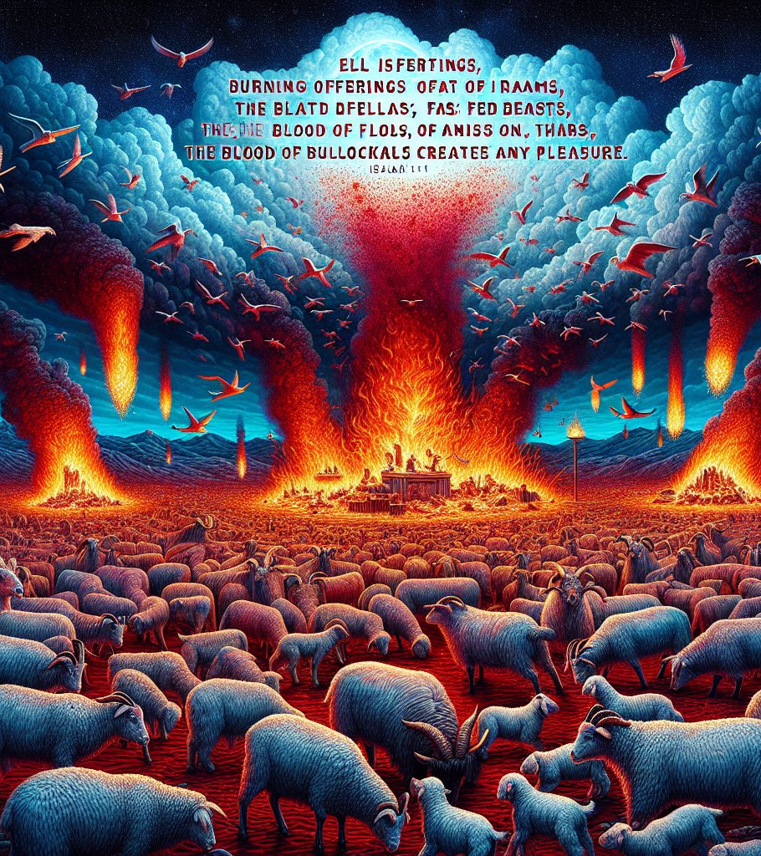
Tradition or Cleanliness?
Isaiah 1:11-17
11 To what purpose is the multitude of your sacrifices unto me? saith the Lord: I am full of the burnt offerings of rams, and the fat of fed beasts; and I delight not in the blood of bullocks, or of lambs, or of he goats.

Slide 53

Tradition or Cleanliness?
Isaiah 1:12-17
12 When ye come to appear before me, who hath required this at your hand, to tread my courts?

Slide 54
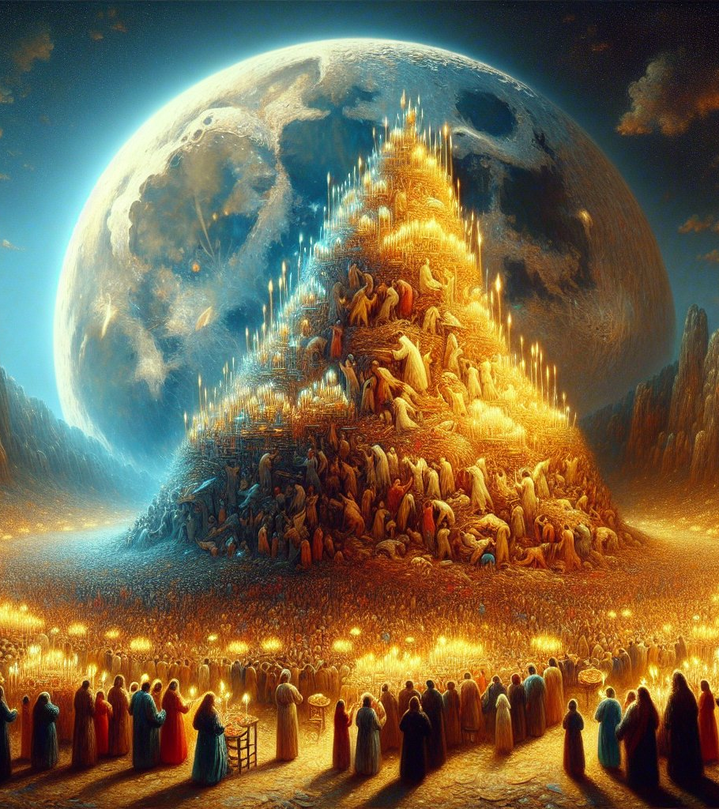
Tradition or Cleanliness?
Isaiah 1:13-17
13 Bring no more vain oblations; incense is an abomination unto me; the new moons and sabbaths, the calling of assemblies, I cannot away with; it is iniquity, even the solemn meeting.

Slide 55
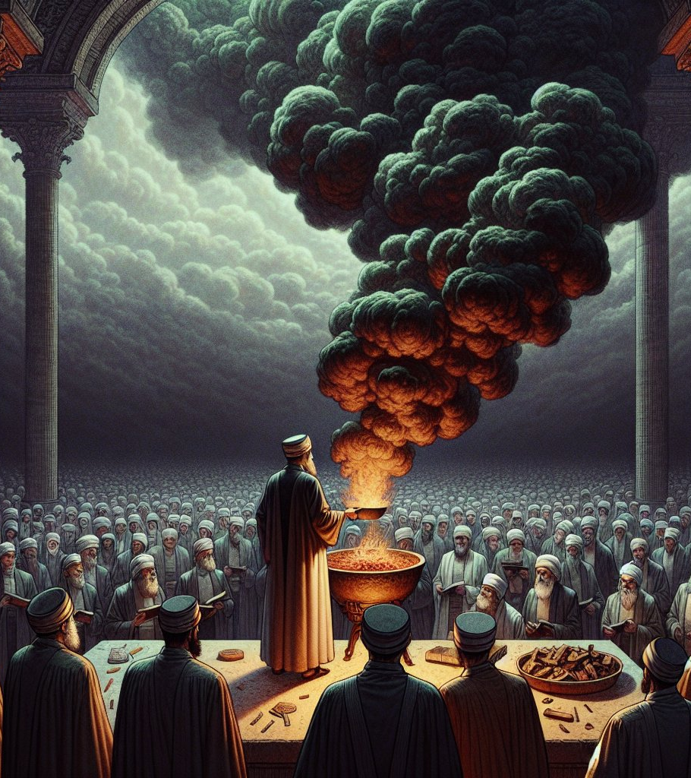
Tradition or Cleanliness?
Isaiah 1:14-17
14 Your new moons and your appointed feasts my soul hateth: they are a trouble unto me; I am weary to bear them.

Slide 56

Tradition or Cleanliness?
Isaiah 1:15-17
15 And when ye spread forth your hands, I will hide mine eyes from you: yea, when ye make many prayers, I will not hear: your hands are full of blood.

Slide 57
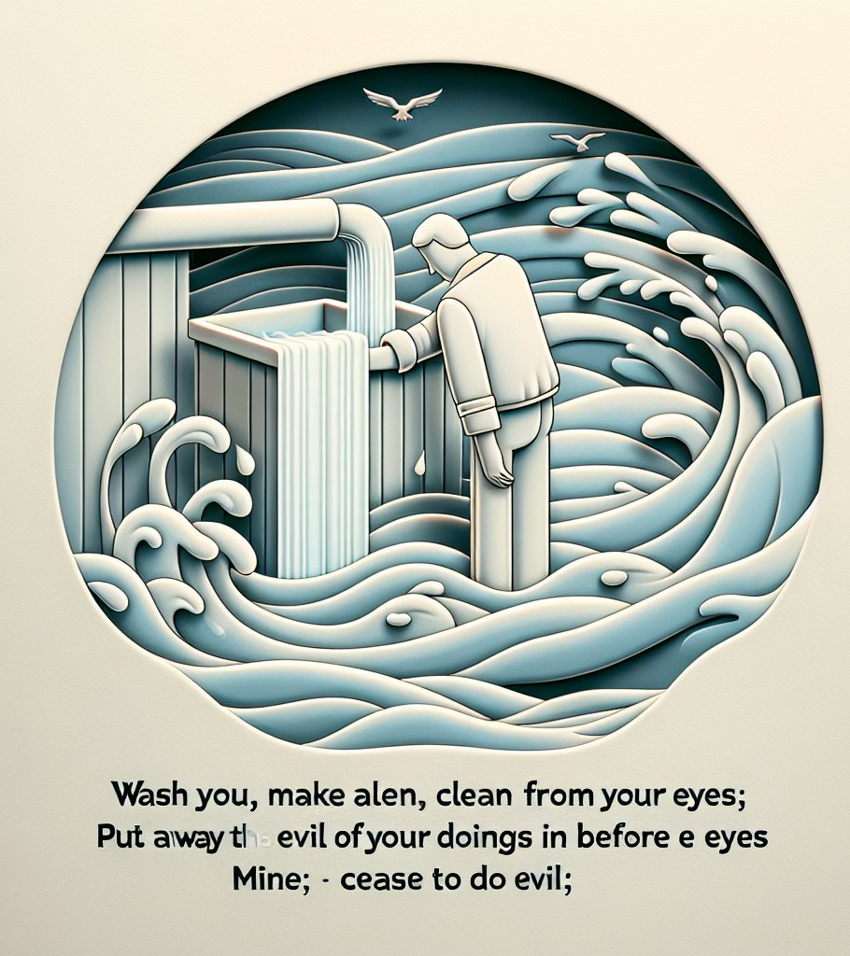
Tradition or Cleanliness?
Isaiah 1:16-17
16 Wash you, make you clean; put away the evil of your doings from before mine eyes; cease to do evil;

Slide 58
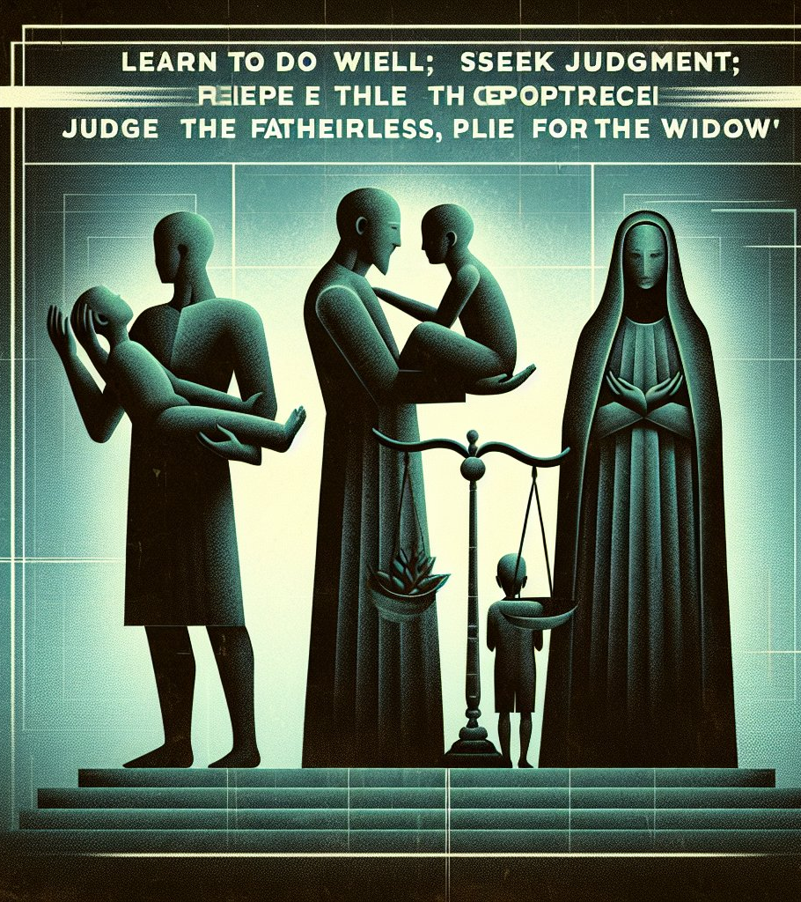
Tradition or Cleanliness?
Isaiah 1:17
17 Learn to do well; seek judgment, relieve the oppressed, judge the fatherless, plead for the widow.

Slide 59
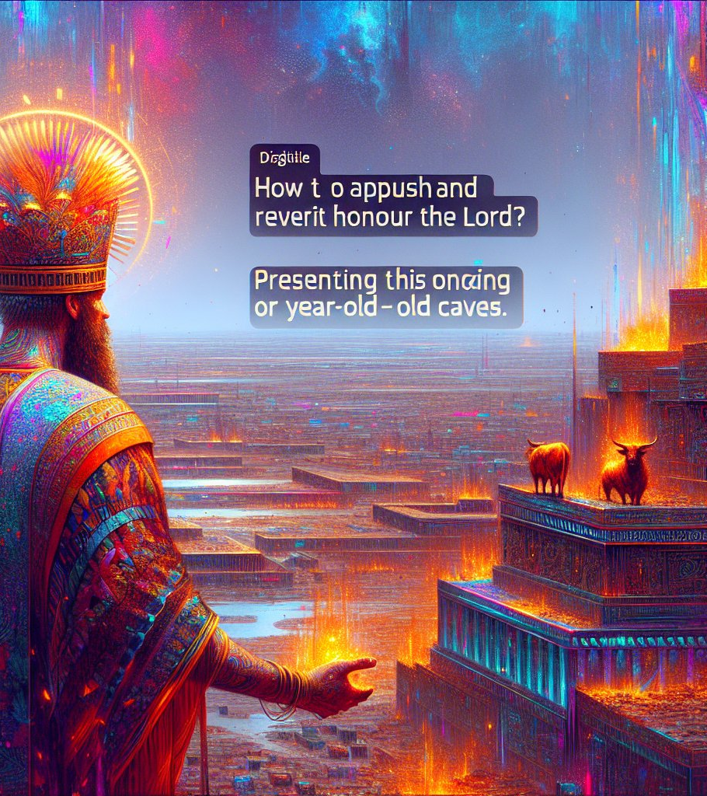
Tradition or Cleanliness?
Micah 6:6-8
6 Wherewith shall I come before the Lord, and bow myself before the high God? shall I come before him with burnt offerings, with calves of a year old?

Slide 60

Tradition or Cleanliness?
Micah 6:6-8
7 Will the Lord be pleased with thousands of rams, or with ten thousands of rivers of oil? shall I give my firstborn for my transgression, the fruit of my body for the sin of my soul?

Slide 61
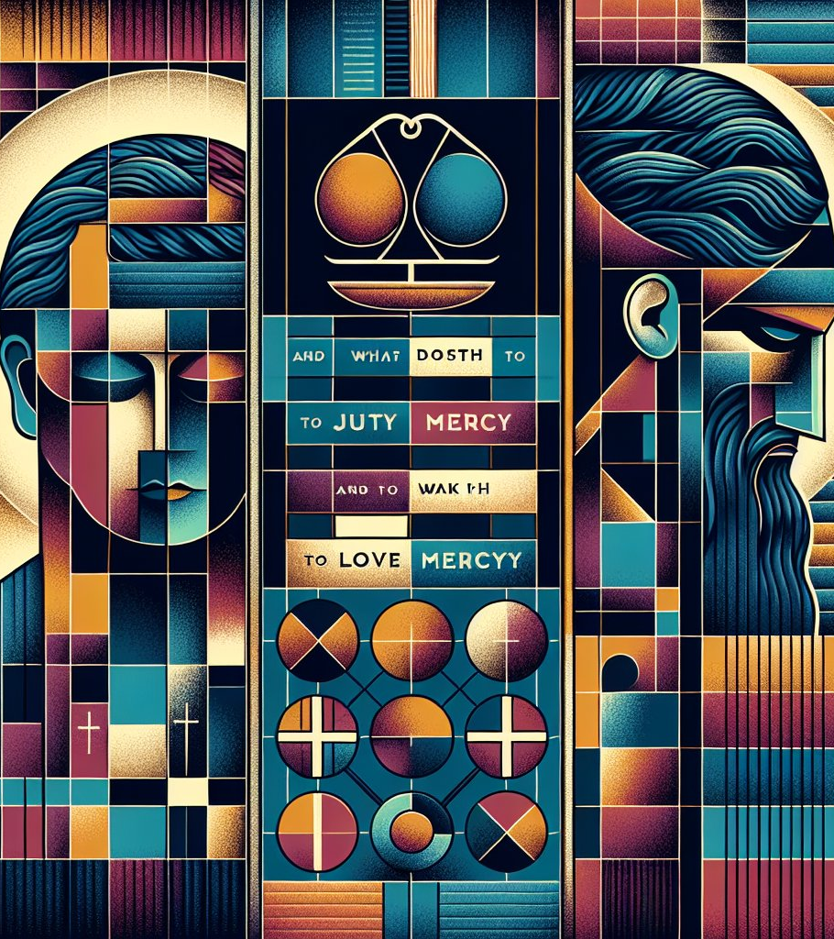
Tradition or Cleanliness?
Micah 6:6-8
8 He hath shewed thee, O man, what is good; and what doth the Lord require of thee, but to do justly, and to love mercy, and to walk humbly with thy God?

Slide 62
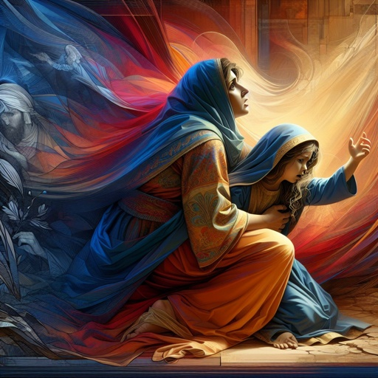
A Daughter Healed
Mark 7:25-31
25 For a certain woman, whose young daughter had an unclean spirit, heard of him, and came and fell at his feet:
26 The woman was a Greek, a Syrophenician by nation; and she besought him that he would cast forth the devil out of her daughter.

Slide 63

A Daughter Healed
Mark 7:27-31
27 But Jesus said unto her, Let the children first be filled: for it is not meet to take the children's bread, and to cast it unto the dogs.
28 And she answered and said unto him, Yes, Lord: yet the dogs under the table eat of the children's crumbs.

Slide 64
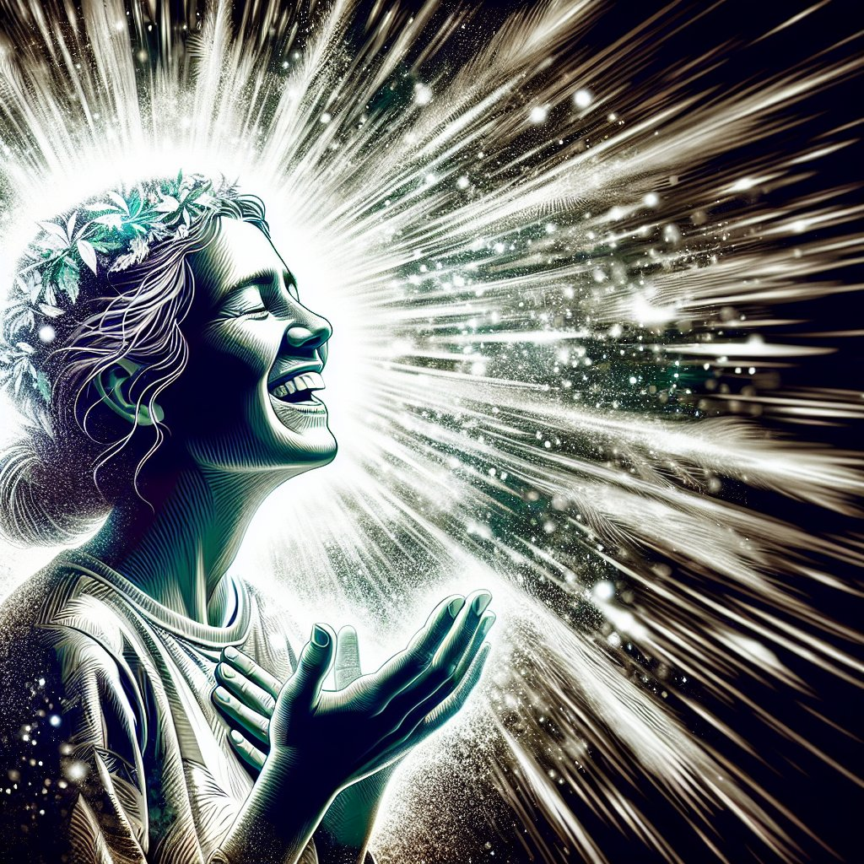
A Daughter Healed
Mark 7:29-31
29 And he said unto her, For this saying go thy way; the devil is gone out of thy daughter.
30 And when she was come to her house, she found the devil gone out, and her daughter laid upon the bed.

Slide 65
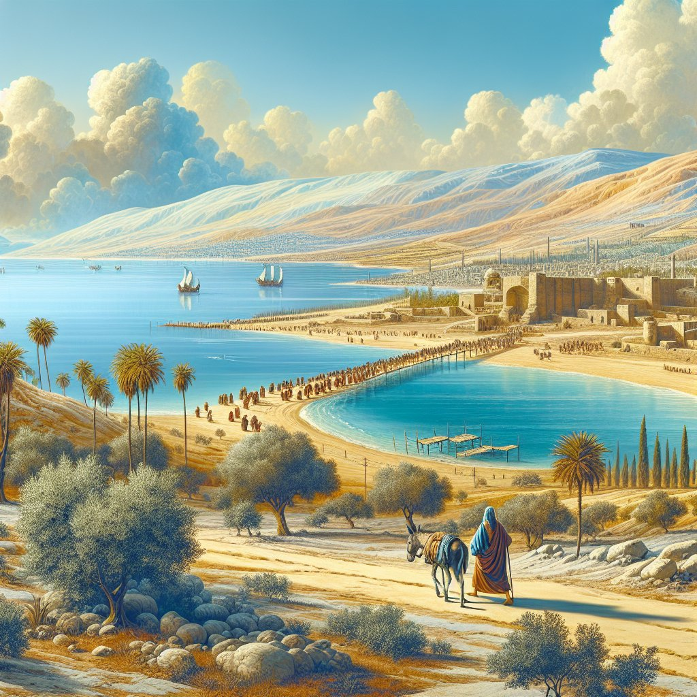
A Daughter Healed
Mark 7:29-31
31 And again, departing from the coasts of Tyre and Sidon, he came unto the sea of Galilee, through the midst of the coasts of Decapolis.

Slide 66
The Desire of Ages pg. 403
“
“In faith the woman of Phoenicia flung herself against the barriers that had been piled up between Jew and Gentile. Against discouragement, regardless of appearances that might have led her to doubt, she trusted the Saviour's love.”
”

Slide 67
The Desire of Ages pg. 403
“
“It is thus that Christ desires us to trust in Him. The blessings of salvation are for every soul. Nothing but his own choice can prevent any man from becoming a partaker of the promise in Christ by the gospel.”
”

Slide 68
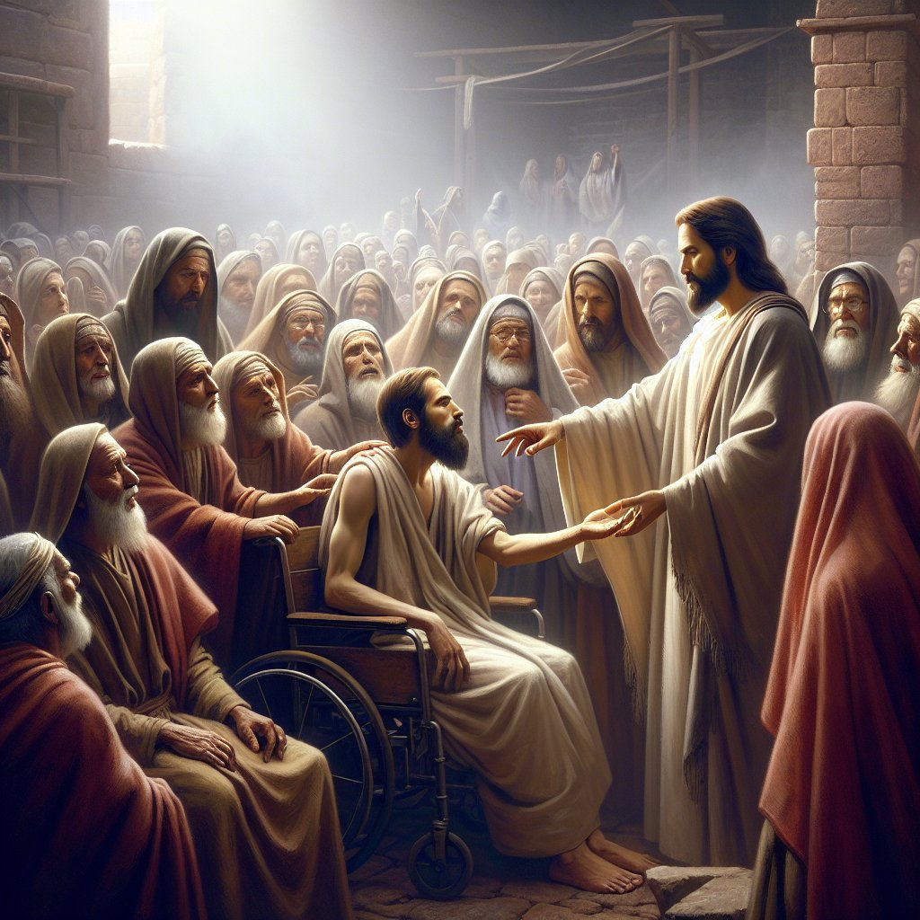
All Things Well
Mark 7:32-37
32 And they bring unto him one that was deaf, and had an impediment in his speech; and they beseech him to put his hand upon him.

Slide 69
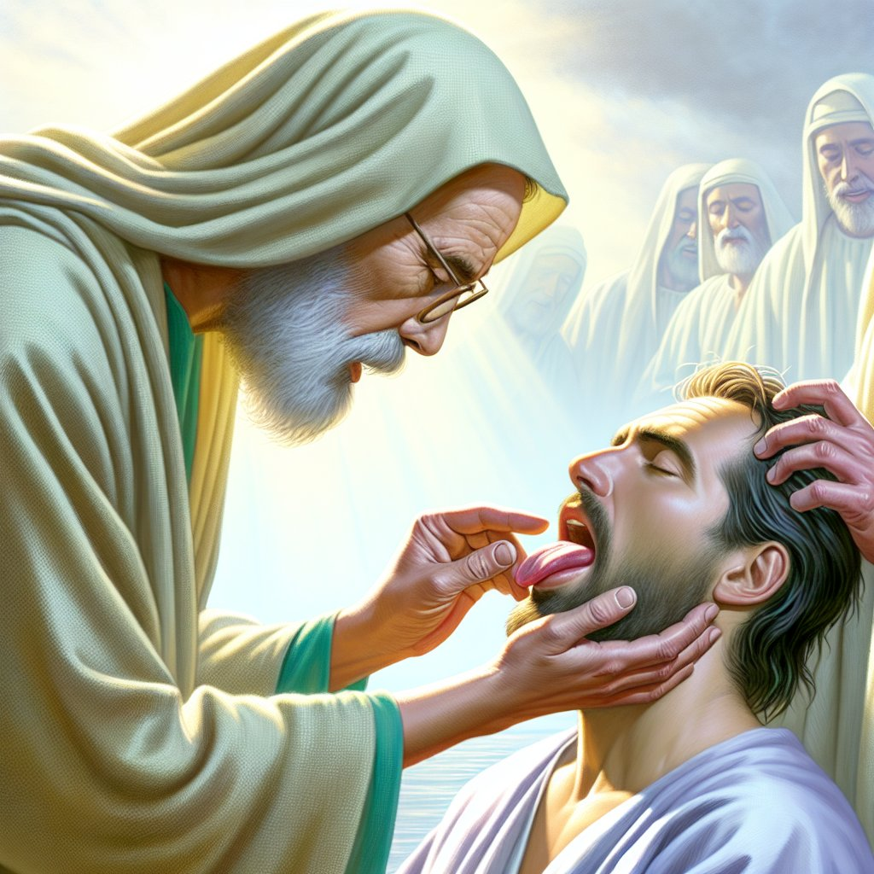
All Things Well
Mark 7:33-37
33 And he took him aside from the multitude, and put his fingers into his ears, and he spit, and touched his tongue;

Slide 70
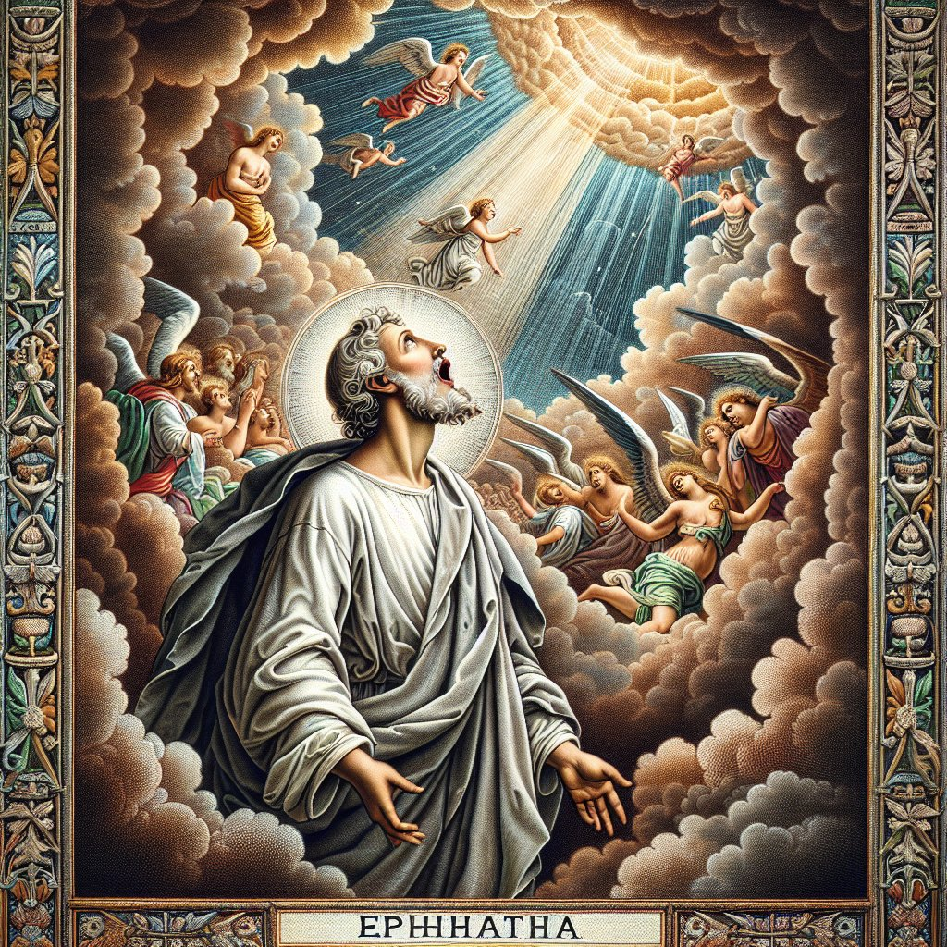
All Things Well
Mark 7:34-37
34 And looking up to heaven, he sighed, and saith unto him, Ephphatha, that is, Be opened.

Slide 71
The Desire of Ages pg. 404
“
“Taking him apart from the multitude, He put His fingers in his ears, and touched his tongue; looking up to heaven, He sighed at thought of the ears that would not be open to the truth, the tongues that refused to acknowledge the Redeemer.”
”

Slide 72
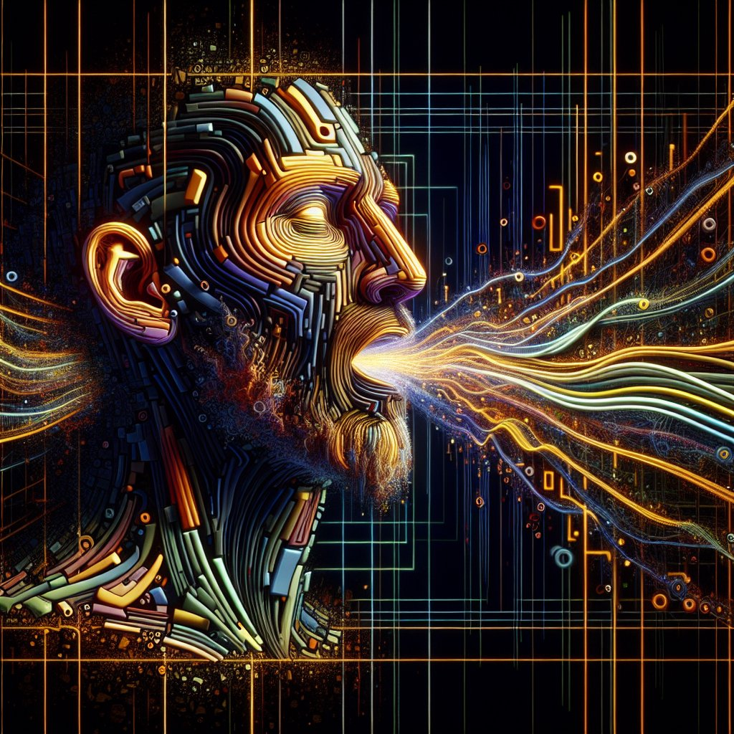
All Things Well
Mark 7:35-37
35 And straightway his ears were opened, and the string of his tongue was loosed, and he spake plain.

Slide 73
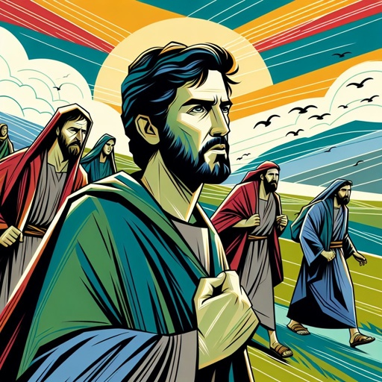
All Things Well
Mark 7:36-37
36 And he charged them that they should tell no man: but the more he charged them, so much the more a great deal they published it;

Slide 74
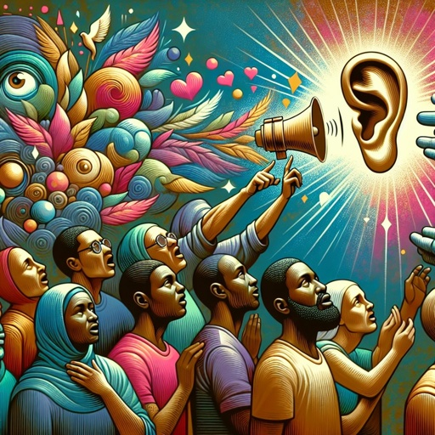
All Things Well
Mark 7:37
37 And were beyond measure astonished, saying, He hath done all things well: he maketh both the deaf to hear, and the dumb to speak.

Slide 75
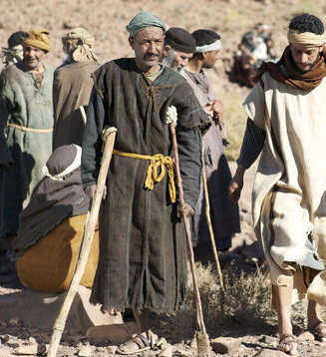
Feeding the Multitude
Mark 8:1-10
The Desire of Ages, p. 404
Jesus went up into a mountain, and there the multitude flocked to Him, bringing their sick and lame, and laying them at His feet. He healed them all; and the people, heathen as they were, glorified the God of Israel.

Slide 76
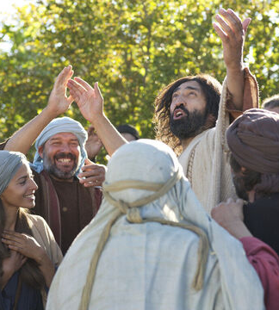
Feeding the Multitude
Mark 8:1-10
The Desire of Ages, p. 404
For three days they continued to throng about the Saviour, sleeping at night in the open air, and through the day pressing eagerly to hear the words of Christ, and to see His works. At the end of three days their food was spent.

Slide 77
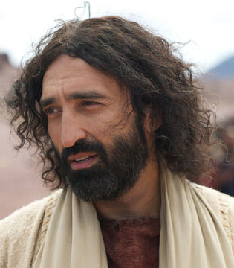
Feeding the Multitude
Mark 8:1-10
The Desire of Ages, p. 404
Jesus would not send them away hungry, and He called upon His disciples to give them food. Again the disciples revealed their unbelief. At Bethsaida they had seen how, with Christ's blessing, their little store availed for the feeding of the multitude; yet they did not now bring forward their all, trusting His power to multiply it for the hungry crowds.

Slide 78
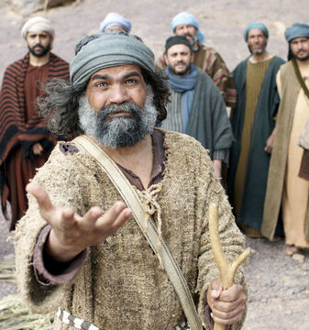
Feeding the Multitude
Mark 8:1-10
The Desire of Ages, p. 404
Moreover, those whom He fed at Bethsaida were Jews; these were Gentiles and heathen. Jewish prejudice was still strong in the hearts of the disciples, and they answered Jesus, “Whence can a man satisfy these men with bread here in the wilderness?”

Slide 79
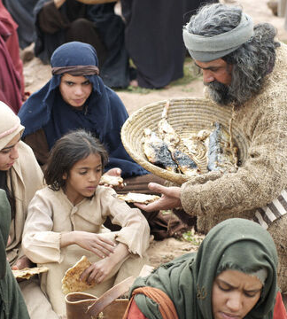
Feeding the Multitude
Mark 8:1-10
The Desire of Ages, p. 404
But obedient to His word they brought Him what they had,—seven loaves and two fishes. The multitude were fed, seven large baskets of fragments remaining. Four thousand men, besides women and children, were thus refreshed, and Jesus sent them away with glad and grateful hearts.

Slide 80
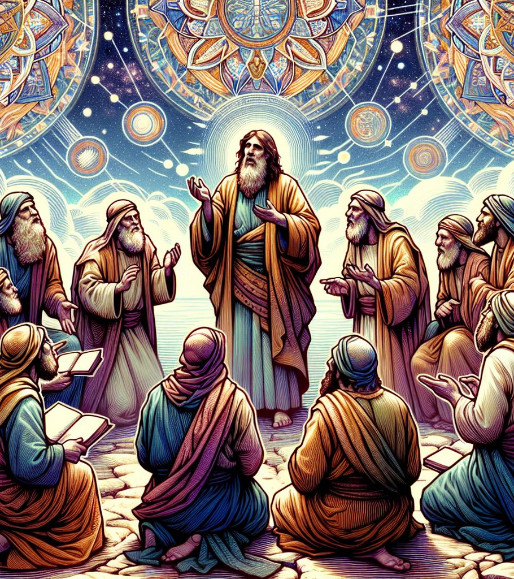
Leaven
Mark 8:11-21
11 And the Pharisees came forth, and began to question with him, seeking of him a sign from heaven, tempting him.

Slide 81
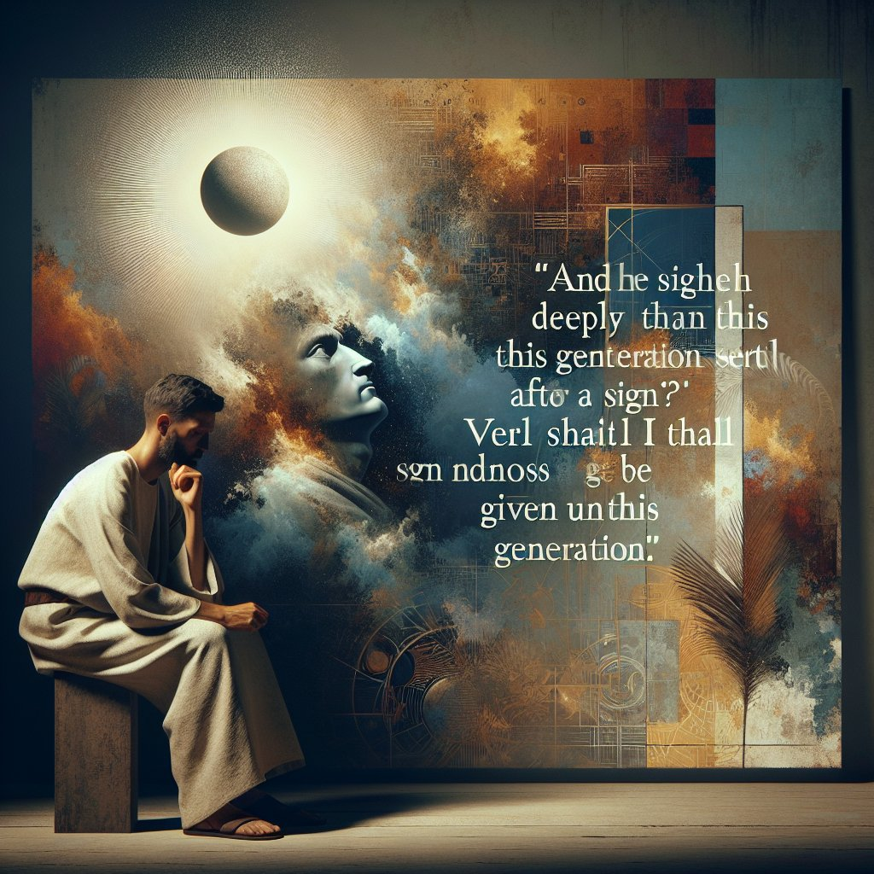
Leaven
Mark 8:12-21
12 And he sighed deeply in his spirit, and saith, Why doth this generation seek after a sign? verily I say unto you, There shall no sign be given unto this generation.

Slide 82

Leaven
Mark 8:13-21
13 And he left them, and entering into the ship again departed to the other side.

Slide 83

Leaven
Mark 8:14-21
14 Now the disciples had forgotten to take bread, neither had they in the ship with them more than one loaf.

Slide 84

Leaven
Mark 8:15-21
15 And he charged them, saying, Take heed, beware of the leaven of the Pharisees, and of the leaven of Herod.

Slide 85

Leaven
Mark 8:16-21
16 And they reasoned among themselves, saying, It is because we have no bread.

Slide 86

Leaven
Mark 8:17-21
17 And when Jesus knew it, he saith unto them, Why reason ye, because ye have no bread? perceive ye not yet, neither understand? have ye your heart yet hardened?

Slide 87

Leaven
Mark 8:18-21
18 Having eyes, see ye not? and having ears, hear ye not? and do ye not remember?

Slide 88

Leaven
Mark 8:19-21
19 When I brake the five loaves among five thousand, how many baskets full of fragments took ye up? They say unto him, Twelve.

Slide 89

Leaven
Mark 8:20-21
20 And when the seven among four thousand, how many baskets full of fragments took ye up? And they said, Seven.

Slide 90

Leaven
Mark 8:21
21 And he said unto them, How is it that ye do not understand?

Slide 91

Leaven
Luke 12:1
In the mean time, when there were gathered together an innumerable multitude of people, insomuch that they trode one upon another, he began to say unto his disciples first of all, Beware ye of the leaven of the Pharisees, which is hypocrisy.

Slide 92
The Desire of Ages pg. 409
“
“Among the followers of our Lord today, as of old, how widespread is this subtle, deceptive sin! How often our service to Christ, our communion with one another, is marred by the secret desire to exalt self! How ready the thought of self-gratulation, and the longing for human approval!”
”

Slide 93
The Desire of Ages pg. 409
“
“It is the love of self, the desire for an easier way than God has appointed that leads to the substitution of human theories and traditions for the divine precepts. To His own disciples the warning words of Christ are spoken, “Take heed and beware of the leaven of the Pharisees.”
”

Slide 94
The Desire of Ages pg. 409
“
“The religion of Christ is sincerity itself. Zeal for God's glory is the motive implanted by the Holy Spirit; and only the effectual working of the Spirit can implant this motive. Only the power of God can banish self-seeking and hypocrisy. This change is the sign of His working.”
”

Slide 95
The Desire of Ages pg. 409
“
“When the faith we accept destroys selfishness and pretense, when it leads us to seek God's glory and not our own, we may know that it is of the right order. “Father, glorify Thy name” (John 12:28), was the keynote of Christ's life, and if we follow Him, this will be the keynote of our life.”
”

Slide 96
The Desire of Ages pg. 409
“
“He commands us to “walk, even as He walked;” and “hereby we do know that we know Him, if we keep His commandments.” 1 John 2:6, 3.”
”

Slide 97
Thank you!
Happy Sabbath!!

